Slide 1
Electrical Safety

Slide 2
1st Rule: Common Sense

Slide 3
https://www.youtube.com/watch?v=SOHDtNQoY70

Slide 4
Electronics Safety - Electric Shock
The main hazards we want to avoid while working on electronic and electrical systems are electric shocks
We’ll cover these things:
What it is
What factors affect how severe it can be
How to avoid it
What to do if you see someone being shocked

Slide 5
Electronics Safety - Electric Shock
What it is
The sensation and muscular spasm caused when electric current passes through your body.
No matter how much voltage is present, a shock only occurs when you provide a ground-path for the electric current.

Slide 6
Electronics Safety - Electric Shock
What factors affect how severe it can be
The following factors determine the severity of the effect electric shock has on your body:
The amount of current that is flowing through your body
The path the current takes through your body
The amount of body resistance you have to the current flow
The length of time the current flows through your body.
Most dangerous paths : hand-hand, left hand - either foot (passes vital organs and heart)
Amt of Rbody: 1500 Ohms (typ. For hand-hand or hand-foot), translates to 146mA current with 220Vac outlet (insert table), 300 Ohms (moist)
Also, breaks in your skin at the point of contact reduce your skin resistance to nearly zero. Skin resistance is only important when you’re handling voltages of less than 240 volts. If you get shocked by more than 240 volts, the voltage arc will burn through your skin and leave deep third-degree burns where it enters your body
Time of current flow: see graph at next page (low levels: 21mA @ >10s, 50mA @ >5s)

Slide 7
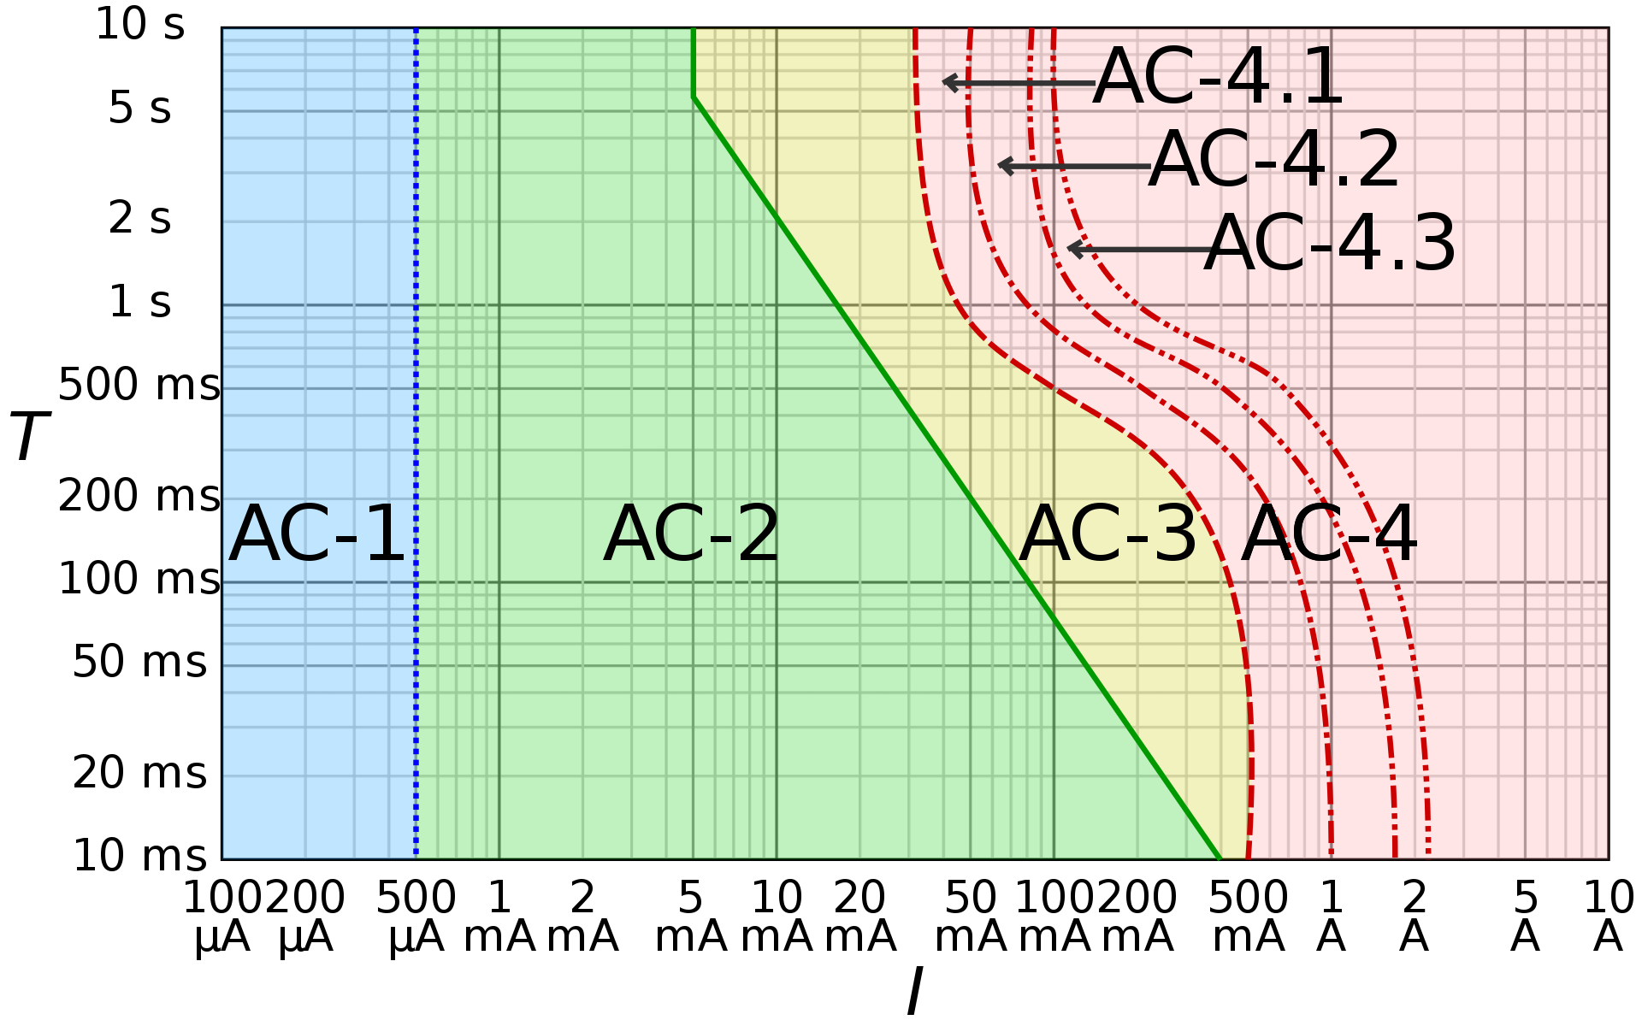
Electronics Safety - Electric Shock
Log-log graph of the effect of alternating current I of duration T passing from left hand to feet as defined in IEC 60479–1.
AC-1: imperceptible
AC-2: perceptible but no muscle reaction
AC-3: muscle contraction with reversible effects
AC-4: possible irreversible effects
AC-4.1: up to 5% probability of ventricular fibrillation
AC-4.2: 5–50% probability of fibrillation
AC-4.3: over 50% probability of fibrillation

Slide 8
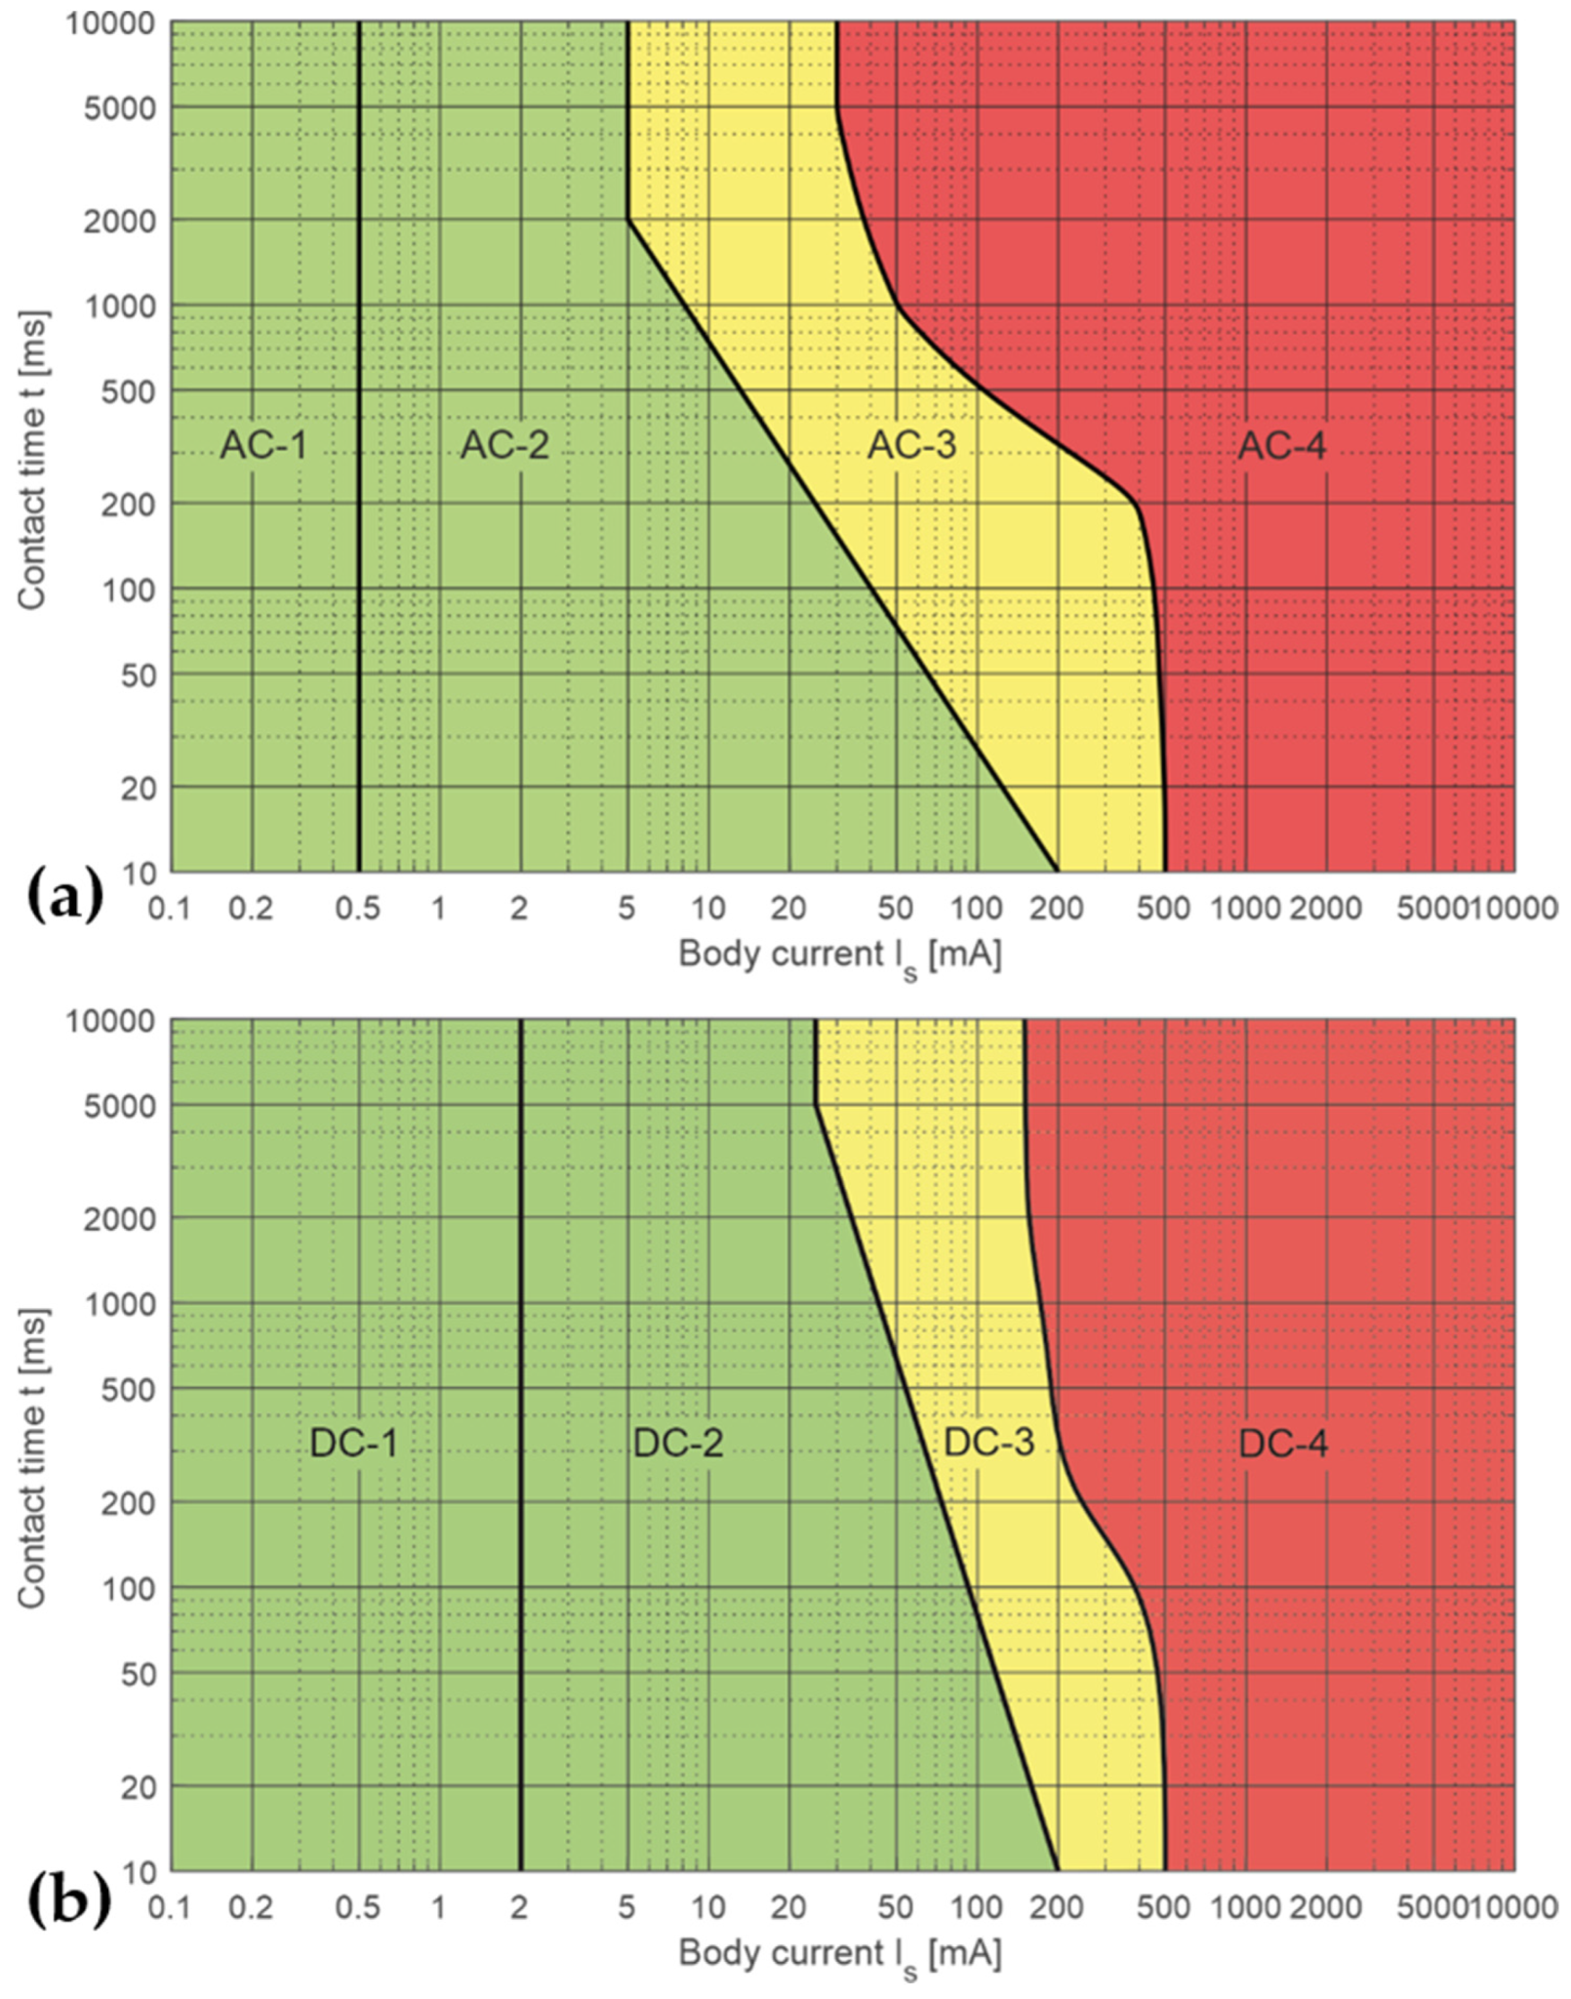

Slide 9
Why not mention it in voltage?

Slide 10
Electronics Safety - Electric Shock
Avoiding electric shock
isolate: Isolate yourself from the source of electric shock; Make sure you are safe before providing or removing the power to any equipment, make sure all electrical equipment covers, doors, and enclosures are kept in place when you’re not actually working on the equipment.
insulate: Make sure the electrical tools and equipment you use are properly insulated (check insulation on power tools), check power and extension cords for damage, wear, cracks, or breaks.
ground: Electric current always follows the path of least resistance; make sure your equipment is well grounded (This will direct any stray electric current to ground, thereby protecting you from electric shock).

Slide 11
Electronics Safety - Electric Shock
Making measurements on Low Voltage systems (<60Vdc)
Study the schematic and wiring diagrams of the equipment on which you’ll be working. Note the location of the points you will be measuring and, also, the location of any other high-voltage points you should be careful not to measure or touch
Always used insulated alligator clips and testing equipment (make sure insulation is present)
Don’t touch conductors and conductive materials without rubber gloves

Slide 12
Electrical Safety - Electric Shock
Making measurements on High Voltage systems (>=60Vdc)
Follow all the previous safety procedures for measuring voltage below 60 volts before beginning your measurements.
Make sure the equipment you are working on is DE-ENERGIZED.
Discharge all high voltage capacitors within the circuit
Make sure the measuring device is setup for the voltage level and polarity to be measured.
Always attach the ground probe of the measuring device first.
Secure the other probe of the measuring device to the test point to be measured.
Energize the equipment under test, make the measurement, and then de-energize the equipment.
Discharge all high-voltage capacitors.
Remove the probes from the equipment

Slide 13
Battery on fire
-water bucket
-fire blanket
-use what u can
https://www.youtube.com/watch?v=s1431hiRKH8

Slide 14
Checking of sources
-Missing Dummy?
-Any short-circuit?
-Metal objects

Slide 15
Voltmeter
In current mode

